Slide 1
Blockchain Task 2 (Pinning Attack)
By- The members of Group 9

Slide 2
What is a Pinning Attack?
A Pinning Attack in blockchain exploits transaction prioritization mechanisms by flooding the network with high-fee transactions to delay or block the inclusion of specific low-fee transactions in mined blocks. In this attack, the attacker creates high-fee transactions that "pin" the miner's attention, filling block space and ensuring that lower-priority transactions are excluded from blocks.
This attack is especially impactful on blockchains like Bitcoin, where block sizes are limited, and transactions with higher fees are typically processed first. By exploiting this mechanism, attackers can achieve outcomes such as delaying competitor transactions, preventing time-sensitive actions, or manipulating decentralized applications reliant on transaction order or timing.

Slide 3
How did we implement the attack?
We implemented the Pinning Attack by designing a feature that generates high-fee transactions when activated. This mechanism, controlled via a toggle button, adds artificially high-fee transactions to the pool of pending transactions. Miners, programmed to prioritize transactions with the highest fees, consistently select these high-fee transactions for inclusion in new blocks. Additionally, the implementation limits mined blocks to the top three highest-fee transactions, ensuring that lower-fee legitimate transactions are excluded from the mining process. This approach effectively delays or blocks the confirmation of regular transactions, showcasing the disruption caused by a pinning attack in the blockchain environment.

Slide 4
Step 1:
Step 2:
Step 3:
Step 4:
Create a transactions with low fees As soon as soon as it is mined, the Pinning Attack begins.
Miners being incentivized from the higher fees mine those transactions
The initial transaction thus gets stuck in the mempool and cannot get processed as miners are busy processing other transactions
Pinning Attack gives the attacker extra time before the transaction is mined to perform whatever malicious activity it wanted to
This way the Pinning Attack gets implemented. Visual representation of this attack is shown in the further slides
A set of fake transactions are created where the miner fees is quite high
They start mining the transaction with the high fees without realising that there is some malicious intent present there.
Now either the initial transaction waits for the pinning transactions to finish getting mined or perform a different transaction with higher miner fees

Slide 5
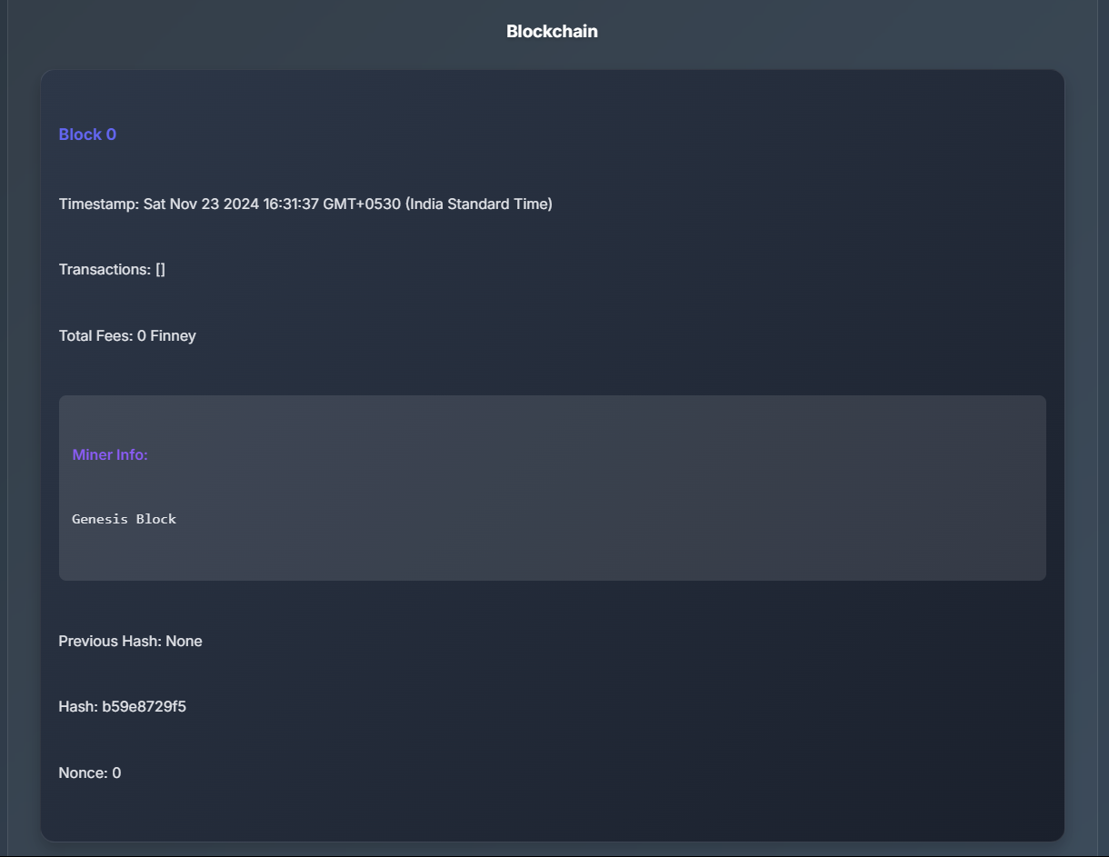
Initial Blockchain-

Slide 6
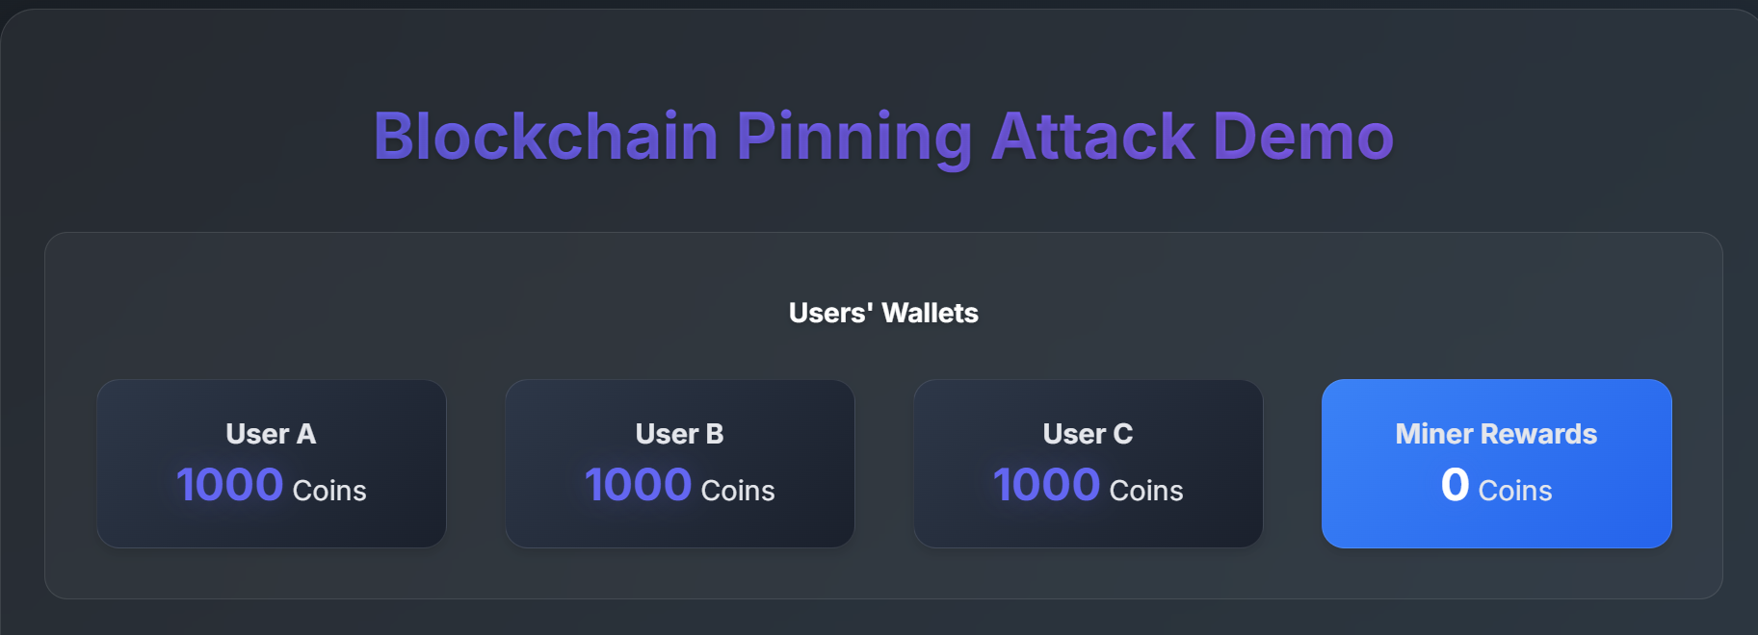
Initial State of the Wallets and Miner Fees

Slide 7
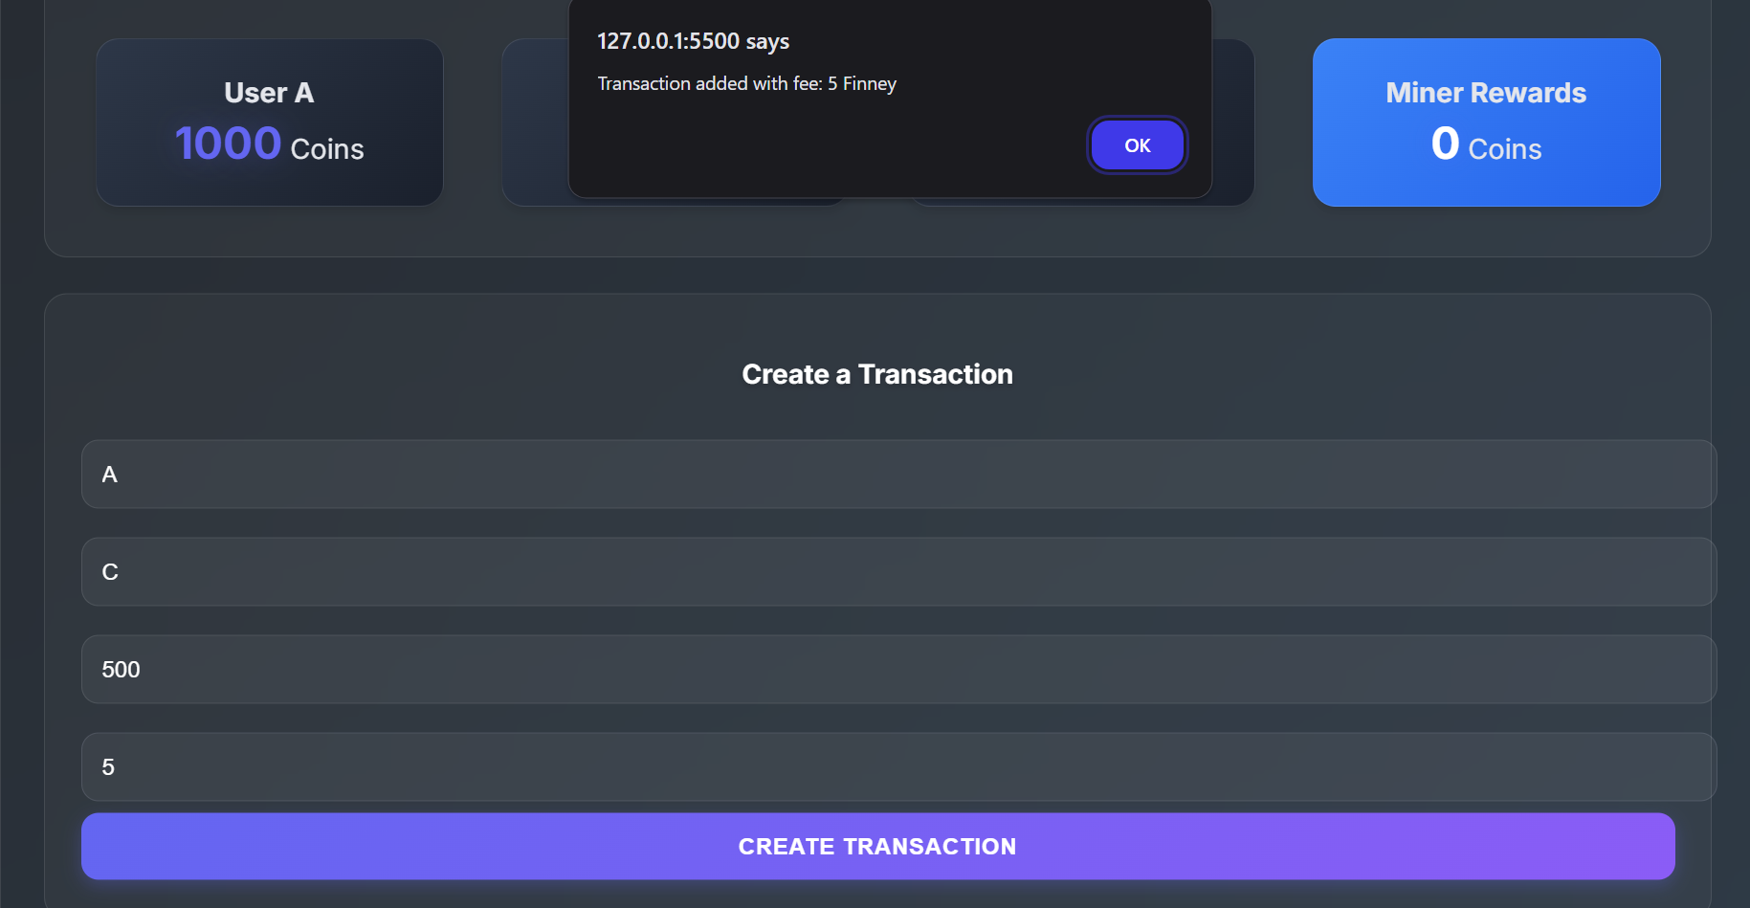
Creation of transaction from A to C-

Slide 8
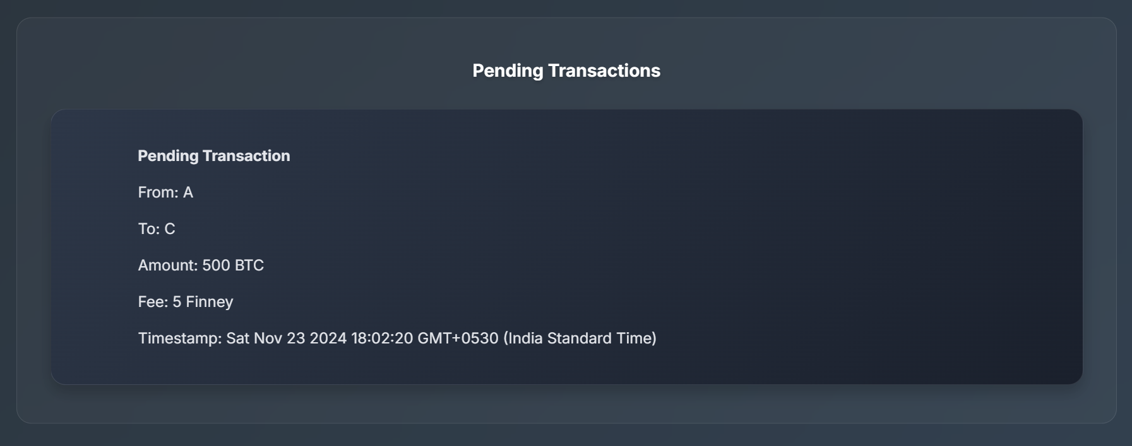
Pending transactions-

Slide 9
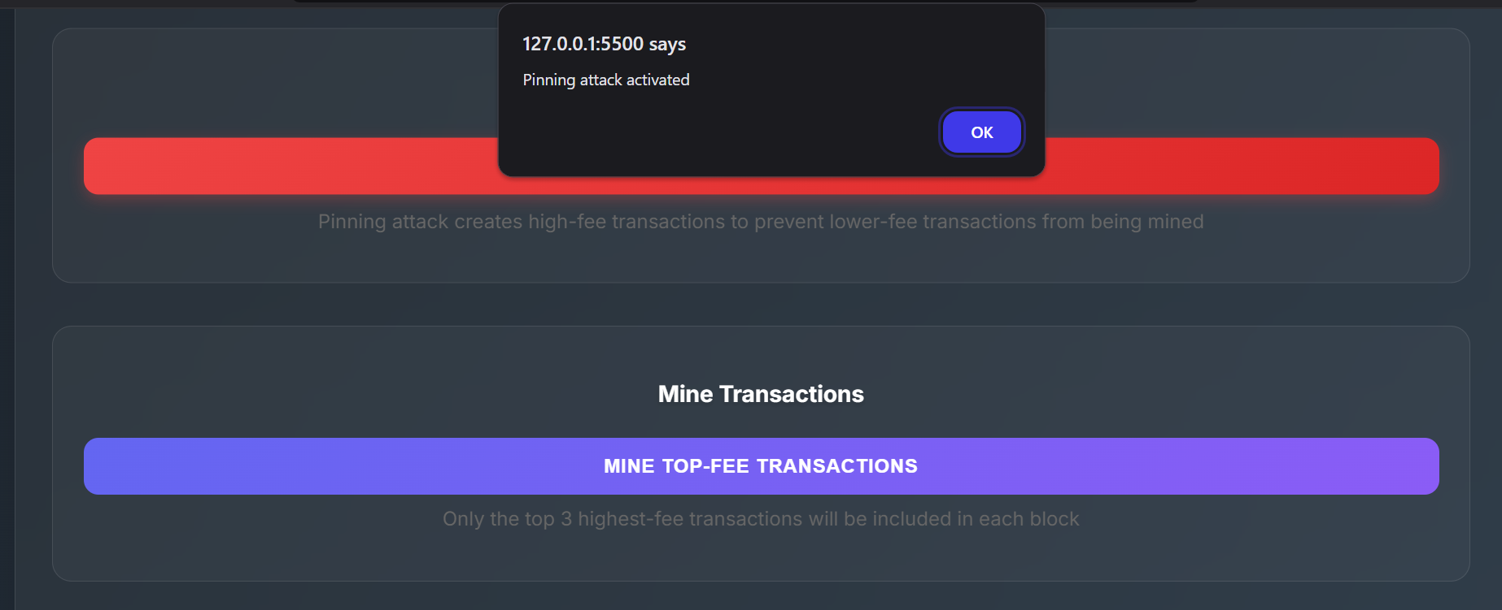
Toggling Pinning Attack

Slide 10
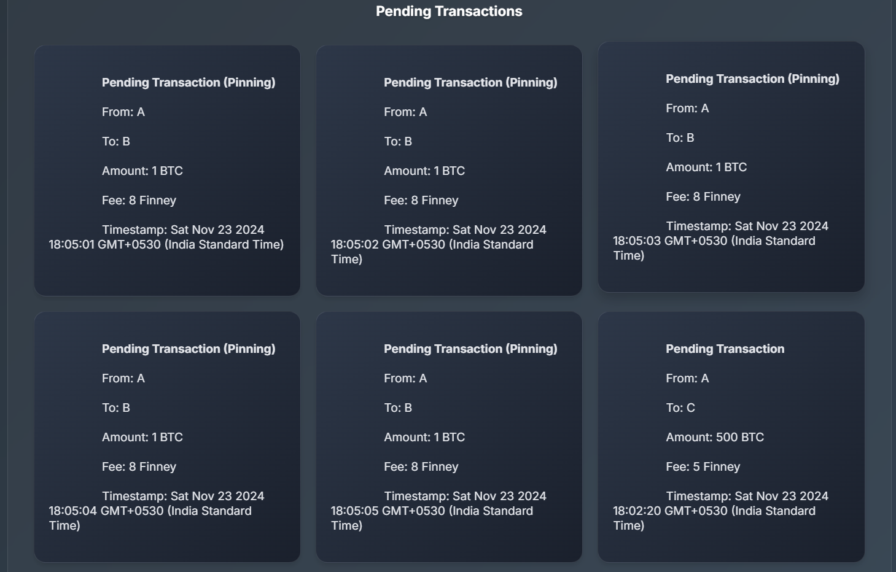
State of Transactions after the attack started-

Slide 11
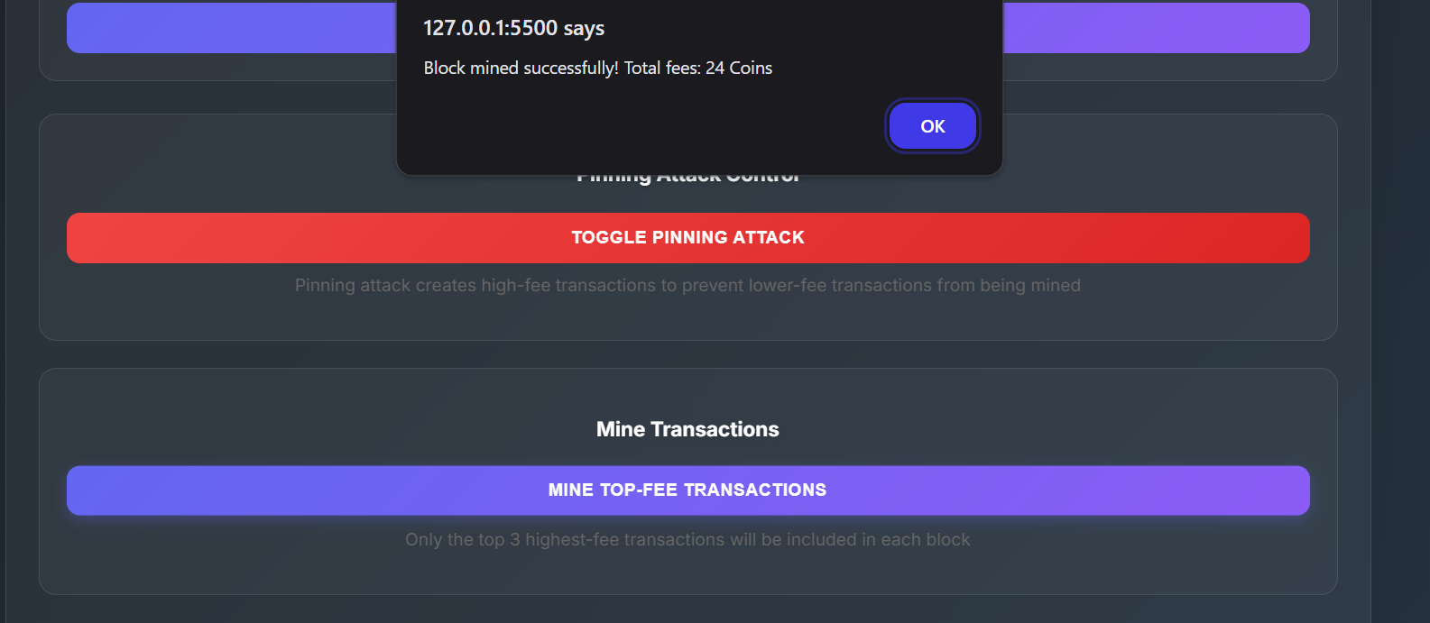
Mining the transactions-

Slide 12
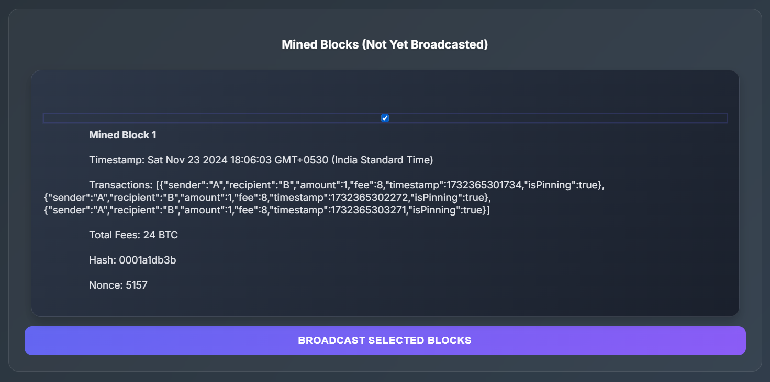
After mining the transactions-

Slide 13
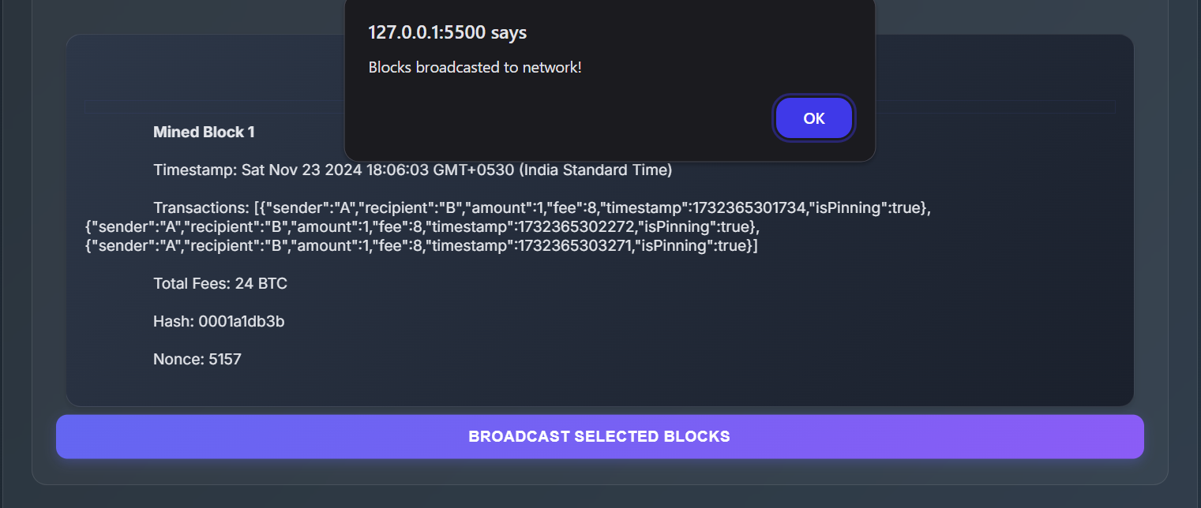
Broadcasting the transactions-

Slide 14
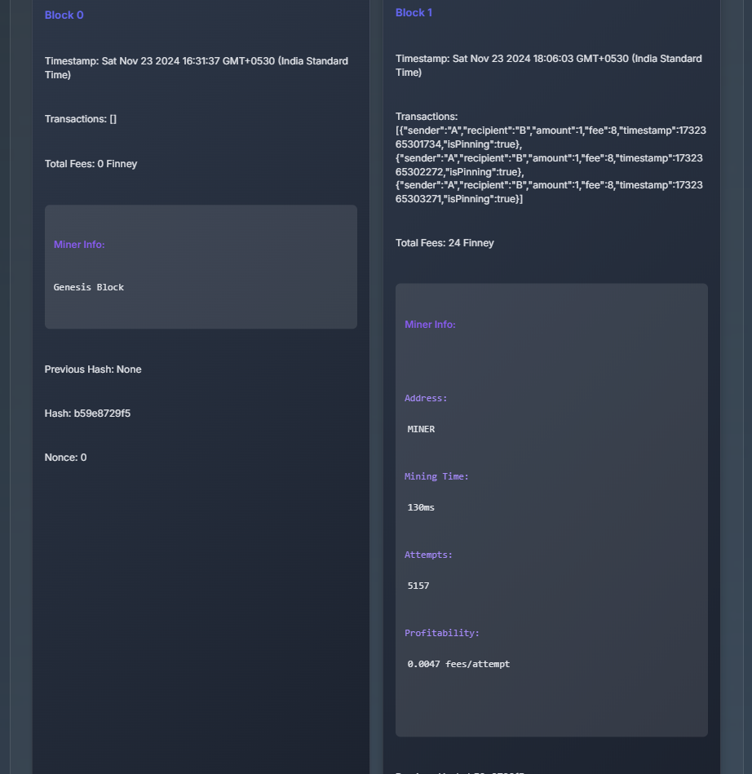
Final Blockchain-

Slide 15
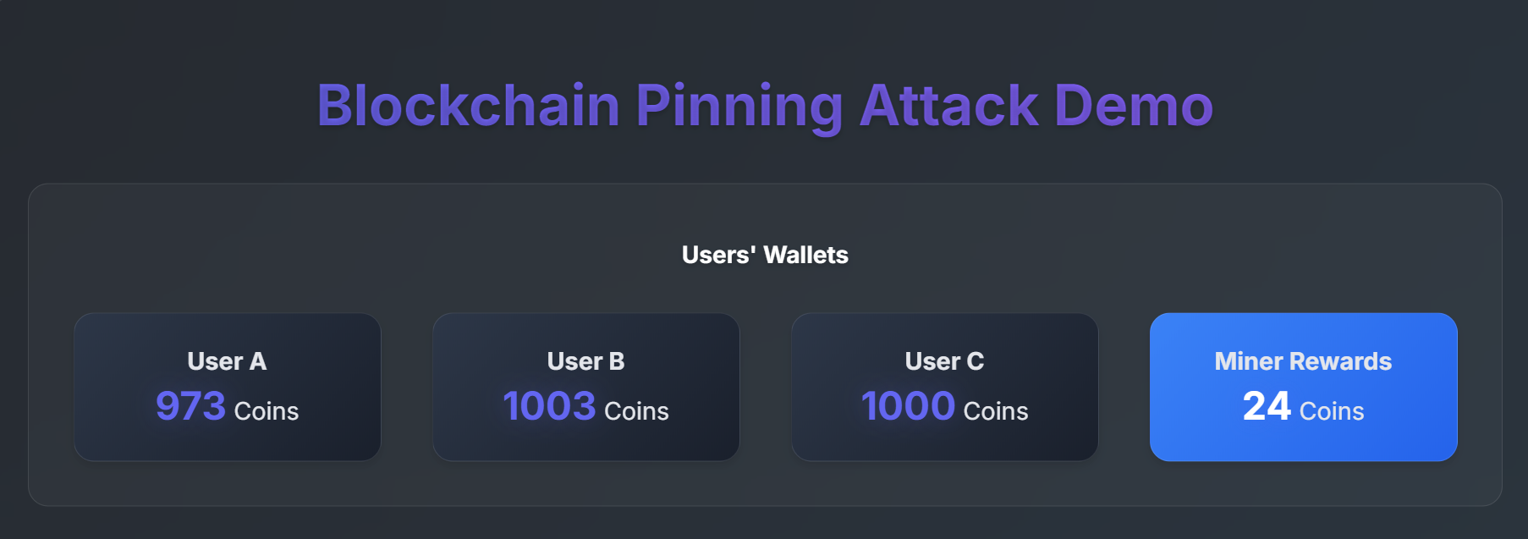
State of the Wallets-

Slide 16
Our actual transaction could not be mined and broadcasted in a block as series of Pinning transactions with higher fees came into the picture thus leading to the transaction being delayed.

Slide 17
Thank you!

